Slide 1

Machine Learning and Corporate Credit Risk Prediction

Slide 2


Outline
- Altman's Z-score and MDA
- A comparison of Machine Learning Models in Bankruptcy Prediction

Slide 3

Altman's Z-Score
Banks, financial institutions, fund managers, lenders, governments and financial market players often seek to develop models to efficiently assess the likelihood of counterparty default.
Knowing the likelihood of default helps when issuing loans, identifying good/bad corporate bonds. Is crucial when investing in distressed securities or shorting firms likely to become distressed.
Altman 1968 was the first to successfully develop an accurate easy-to-use control measure of financial distress for public companies based on multiple corporate income and balance sheet values.

Slide 4
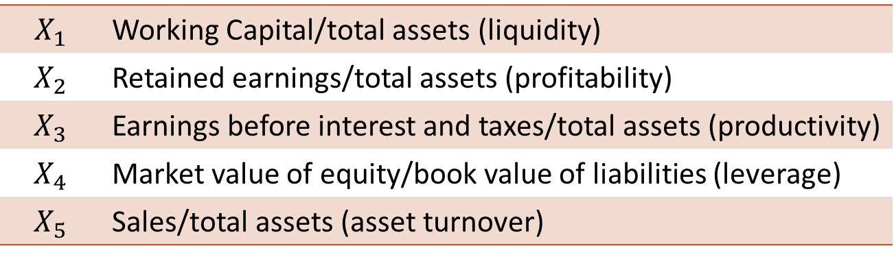
Altman's Z-Score
Data:
Originally Altman identified a set of large manufacturing firms which had declared bankruptcy and then collected a matched sample of firms which had survived.
Altman started with 22 different financial and accounting ratios and subsequently identified five he found were strong indictors of financial health of public manufacturing firms over the next two years:
$$X_{1}$$ | Working Capital/total assets (liquidity)
$$X_{2}$$ | Retained earnings/total assets (profitability)
$$X_{3}$$ | Earnings before interest and taxes/total assets (productivity)
$$X_{4}$$ | Market value of equity/book value of liabilities (leverage)
$$X_{5}$$ | Sales/total assets (asset turnover)

Slide 5

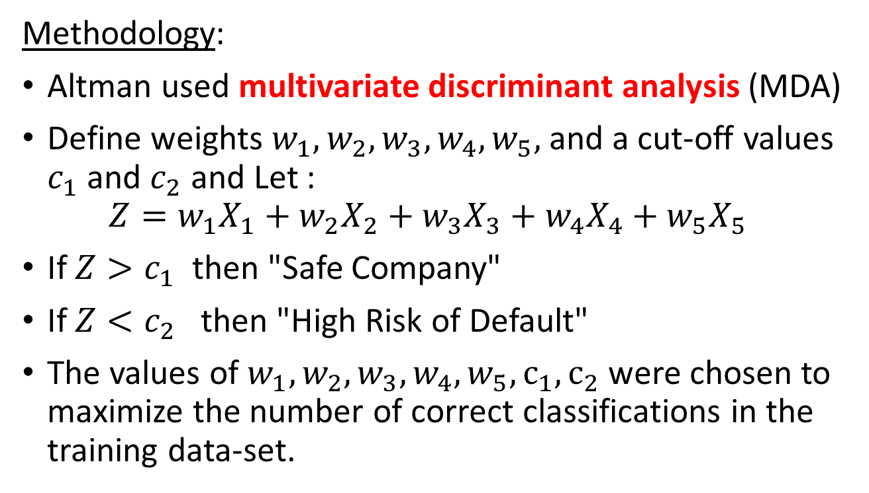
Altman's Z-Score
Methodology:
Altman used multivariate discriminant analysis (MDA)
Define weights $w_{1},w_{2},w_{3},w_{4},w_{5},$ and a cut-off values $c_{1}$ and $c_{2}$ and Let : $Z=w_{1}X_{1}+w_{2}X_{2}+w_{3}X_{3}+w_{4}X_{4}+w_{5}X_{5}$
If $Z>c_{1}$ then "Safe Company"
If $Z<c_{2}$ then "High Risk of Default"
The values of $w_{1},w_{2},w_{3},w_{4},w_{5},c_{1},c_{2}$ were chosen to maximize the number of correct classifications in the training data-set.
Notes:
Multiple Discriminant Analysis is a multivariate dimensionality reduction technique. It has been used to predict signals as diverse as neural memory traces and corporate failure. MDA is not directly used to perform classification

Slide 6
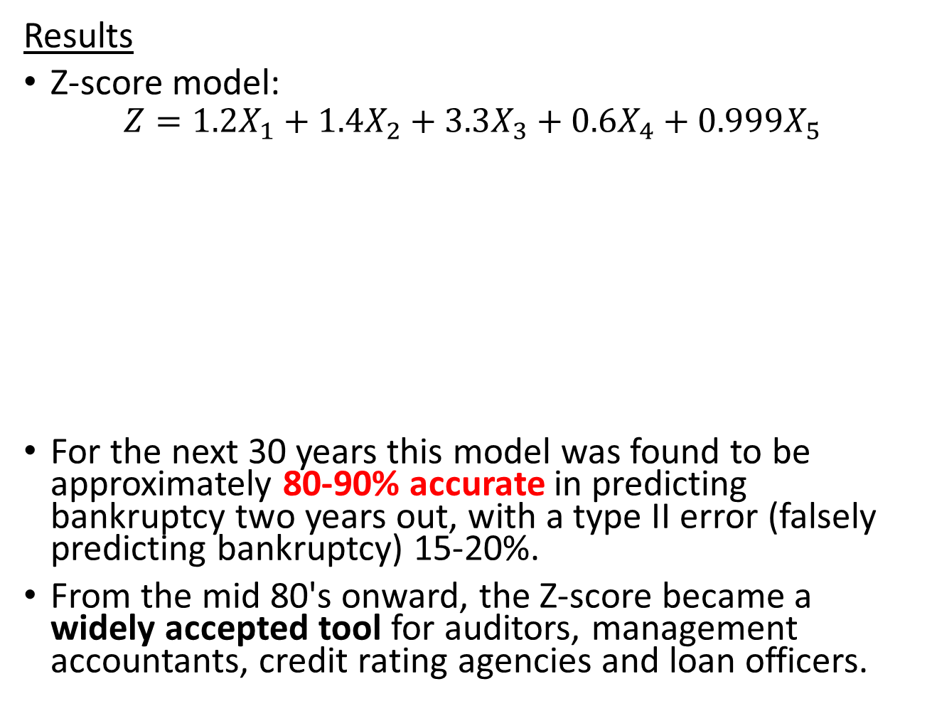


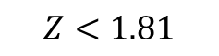
Altman's Z-Score
High Risk Default
Gray Area
Safe
Results
Z-score model:
$$Z=1.2X_{1}+1.4X_{2}+3.3X_{3}+0.6X_{4}+0.999X_{5}$$
For the next 30 years this model was found to be approximately 80-90% accurate in predicting bankruptcy two years out, with a type II error (falsely predicting bankruptcy) 15-20%.
From the mid 80's onward, the Z-score became a widely accepted tool for auditors, management accountants, credit rating agencies and loan officers.
$$Z<1.81$$
$$1.81<Z<2.99$$
$$Z>2.99$$

Slide 7
Results (continued…)
In 2007, the credit ratings of relevant securities had been rated higher by the rating agencies than predicted by the Z-score.
Altman calculated that the median Altman Z-score of companies in 2007 was 1.81. These companies' credit ratings were equivalent to B. This indicated that 50% of the firms should have been rated lower, and they were highly distressed and had a high probability of becoming bankrupt.
Altman's calculations led him to believe that a crisis would occur and there would be a meltdown in the credit market. Altman believed the crisis would stem from corporate defaults, but the meltdown began with mortgage-backed securities (MBS). However, corporations soon defaulted in 2009 at the second-highest rate in history.

Slide 8

Results (continued…)
In 2009, Morgan Stanley strategy analyst, Graham Secker, used the Z-score to rank a basket of European companies. He found that the companies with the weaker balance sheets underperformed the market two thirds of the time. Morgan Stanley also found that a company with an Altman Z-score of less than 1 tended to underperform the wider market by more than 4%.

Slide 9

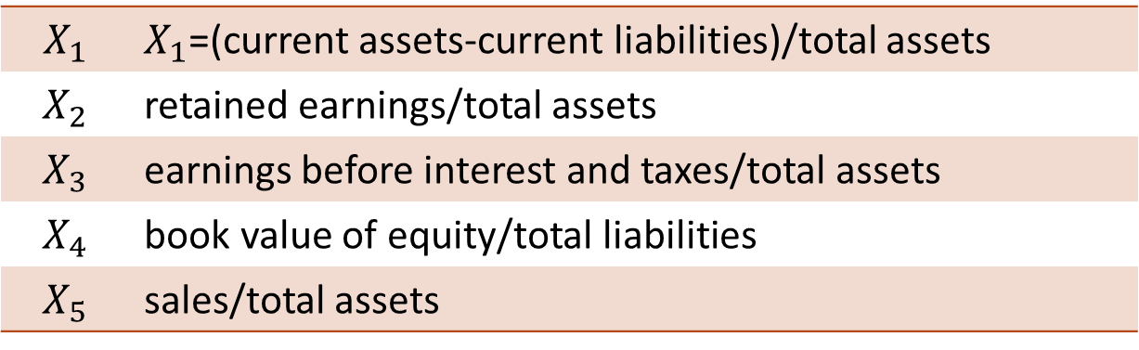
Extension of Z-Score
In 2002 Altman published a model (Z'-Score) for private firms.
Once again 5 predictor variables were identified:
Altman also developed a model for non-manufacturers and emerging markets using only the first four of the above ratios.
$$X_{1}$$ | $X_{1}$=(current assets-current liabilities)/total assets
$$X_{2}$$ | retained earnings/total assets
$$X_{3}$$ | earnings before interest and taxes/total assets
$$X_{4}$$ | book value of equity/total liabilities
$$X_{5}$$ | sales/total assets

Slide 10

Ohlson 1980
In 1980, Olhson applied logistic regression to the problem of bankruptcy prediction.
In contrast to MDA, logistic regression calculates a default probability of the potential borrower.

Slide 11
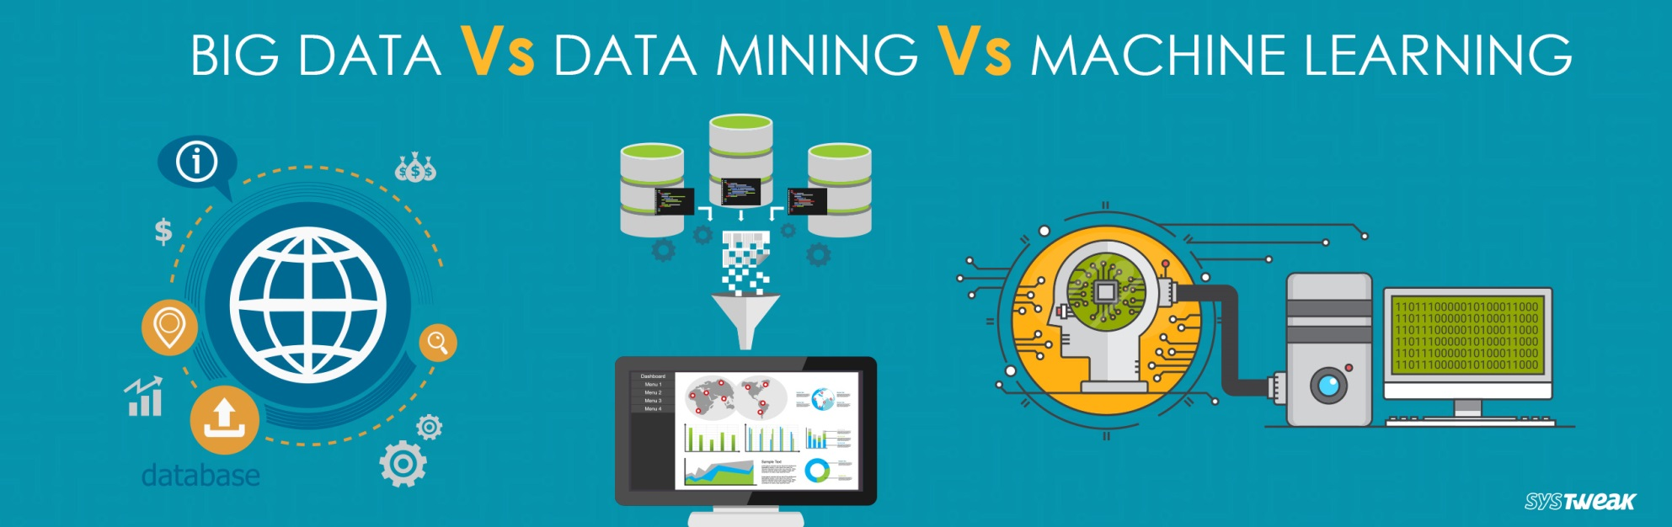
Artificial Intelligence and Machine Learning Revolution
In 1996 Begley, Ming and Watts argued that popular models based on MDA and Logistic Regression had become inaccurate.
The acceleration of machine learning and the availability of big data offered a new opportunity to improve corporate credit risk analysis.
Since credit risk analysis is similar to pattern-recognition problems, machine learning algorithms can be used to classify the credit worthiness of counterparties.
Notes:
Big Data: Big data primarily refers to data sets that are too large or complex to be dealt with by traditional data-processing application software. Data with many entries offer greater statistical power, while data with higher complexity may lead to a higher false discovery rate.
Data mining is the process of extracting and discovering patterns in large data sets involving methods at the intersection of machine learning, statistics, and database systems
Machine Learning is an AI technique that teaches computers to learn from experience. Machine learning algorithms use computational methods to “learn” information directly from data without relying on a predetermined equation as a model.

Slide 12


Barboza, Kimura and Altman 2017
In a recent paper in 2017 by: Barboza, Kimura and Altman machine learning models such as: Neural Nets (NN), linear/nonlinear Support Vector Machines (SVM), and random forests (RF), along with the meta algorithms of Boosting and Bagging, where compared to traditional models of MDA and Logistic regression. (All techniques available in R)
A data set of 13,300 firms were used to test the various algorithms.

Slide 13


Recall Some Popular Classification Algorithms
Linear SVM
Decision Trees
Neural Networks
Notes:
There are sometimes called Learners

Slide 14

Barboza, Kimura and Altman 2017
Six new predictor variables in addition to Altman's original five were added including:
Earnings before interest and taxes/sales
(Total assets at time t-Total assets at time t-1)/Total assets at t-1
(Sales time t- Sales at t-1)/Sales at t-1
(# employees time t-# employees time t-1)/ # employees time t-1
ROE time t-ROE time t-1, where ROE=Net Income/stockholders equity
Price-to-Book time t-Price-to-Book time t-1 where Price-to-Book =(Market value per share)/(Book value per share)

Slide 15

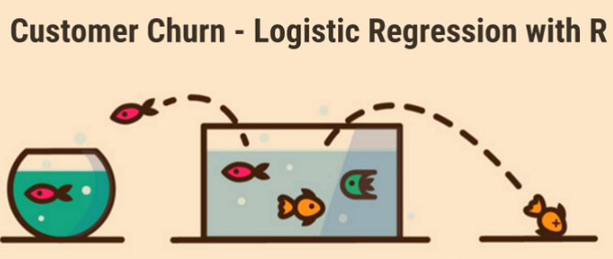
Barboza, Kimura and Altman 2017
Barboza et. al. found that machine learning algorithms performed significantly better than MDA (Altman's Z) and logistic regression.
Addition of the new predictor variables also improved predictions.
Results are summarized in the next slide.
Logistics regression
vs

Slide 16
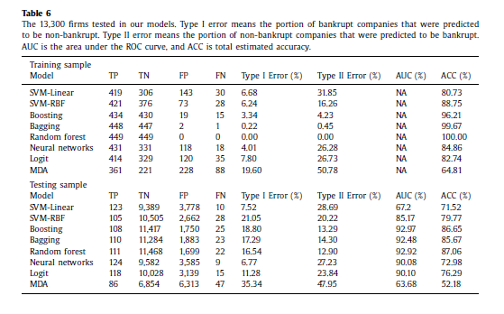
Barboza, Kimura and Altman 2017 Testing Results

Slide 17


Conclusions
Machine learning and artificial intelligence can be used to significantly improve corporate credit risk assessment and prediction.
Potentially similar types of tools may be useful in identifying and assessing other types of credit risk such as mortgages or retail loans.
New models with other predictive variables using other advanced algorithms are just waiting to be found that might improve these results further.

Slide 18
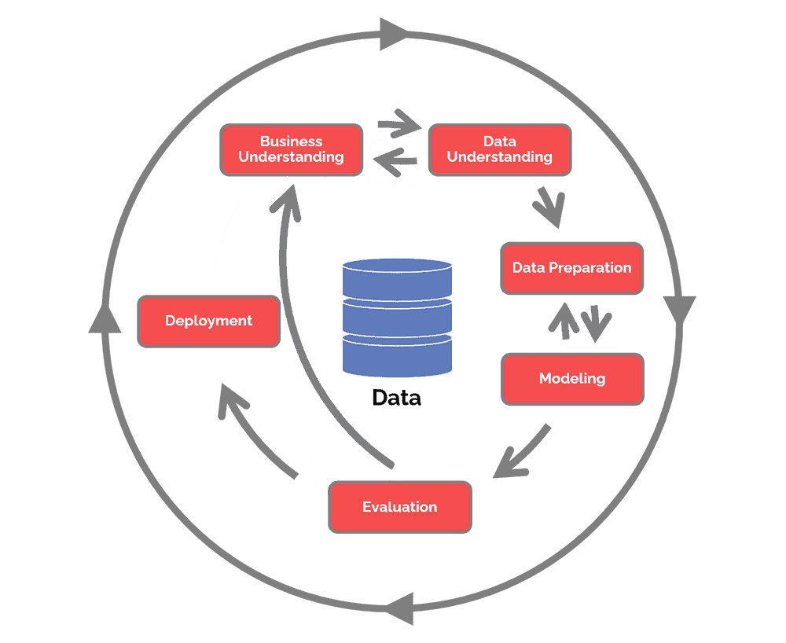
CRISP DM

Slide 19
CRISP-DM
The CRoss Industry Standard Process for Data Mining (CRISP-DM) is a process model that serves as the base for a data science process. It has six sequential phases:
Business understanding – What does the business need?
Data understanding – What data do we have / need? Is it clean?
Data preparation – How do we organize the data for modeling?
Modeling – What modeling techniques should we apply?
Evaluation – Which model best meets the business objectives?
Deployment – How do stakeholders access the results?
Published in 1999 to standardize data mining processes across industries, it has since become the most common methodology for data mining, analytics, and data science projects.
Data science teams that combine a loose implementation of CRISP-DM with overarching team-based agile project management approaches will likely see the best results.

